Slide 1
Restricted Boltzmann Machine A Basic Building Block of DNN
梁伟东(Weidoliang)

Slide 2
Topics
Restricted Boltzmann Machines
Classification RBM
SparseClassRBM for pCTR

Slide 3
RBM

Slide 4
RBM – A Graphical Model
$$E\left(\overset{⃑}{v},\overset{⃑}{h}\right)=$$
$$−\sum_{i=1}^{n}{\sum_{j=1}^{m}{w_{ij}h_{i}v_{j}}}−\sum_{j=1}^{m}{b_{j}v_{j}}−\sum_{i=1}^{n}{c_{i}h_{i}}$$
𝐸(𝑣 ⃑,ℎ ⃑ )=
−∑_(𝑖=1)^𝑛▒∑_(𝑗=1)^𝑚▒〖𝑤_𝑖𝑗 ℎ_𝑖 𝑣_𝑗 〗−∑_(𝑗=1)^𝑚▒〖𝑏_𝑗 𝑣_𝑗 〗−∑_(𝑖=1)^𝑛▒〖𝑐_𝑖 ℎ_𝑖 〗
$$Z=\sum_{\overset{⃑}{v^{′}}}{\sum_{\overset{⃑}{h^{′}}}{e^{−E(\overset{⃑}{v^{′}},\overset{⃑}{h^{′}}）}}}$$
𝑍=∑_(𝑣^′ ) ⃑▒∑_(ℎ^′ ) ⃑▒𝑒^(−𝐸((𝑣^′ ) ⃑,(ℎ^′ ) ⃑）)
$$p\left(\overset{⃑}{v},\overset{⃑}{h}\right)=\frac{1}{Z}e^{−E(\overset{⃑}{v},\overset{⃑}{h})}$$
𝑝(𝑣 ⃑,ℎ ⃑ )=1/𝑍 𝑒^(−𝐸(𝑣 ⃑,ℎ ⃑))
RBM
Binary Visible and Hidden Units
RBM

Slide 5
RBM
Visible units: what we have observed
Hidden units: high level concepts obtained from visible units.

Slide 6
RBM Conditional Independence
$$p\left(\overset{⃑}{v}|\overset{⃑}{h}\right)=\prod_{j=1}^{m}{p\left(v_{j} | \overset{⃑}{h}\right)}$$
𝑝(𝑣 ⃑|ℎ ⃑ )=∏_(𝑗=1)^𝑚▒〖𝑝(𝑣_𝑗│ℎ ⃑ ) 〗
$$p\left(v_{j}=1 | \overset{⃑}{h}\right)=σ(\sum_{i=1}^{n}{W_{ij}h_{i}+b_{j}})$$
𝑝(𝑣_𝑗=1│ℎ ⃑ )=𝜎(∑_(𝑖=1)^𝑛▒〖𝑊_𝑖𝑗 ℎ_𝑖+𝑏_𝑗 〗)
$$p\left(h_{i}=1 | \overset{⃑}{v}\right)=σ(\sum_{j=1}^{m}{W_{ij}v_{j}+c_{i}})$$
𝑝(ℎ_𝑖=1│𝑣 ⃑ )=𝜎(∑_(𝑗=1)^𝑚▒〖𝑊_𝑖𝑗 𝑣_𝑗+𝑐_𝑖 〗)
$$p\left(\overset{⃑}{h}|\overset{⃑}{v} \right)=\prod_{i=1}^{n}{p\left(h_{i} | \overset{⃑}{v}\right)}$$
𝑝(ℎ ⃑|𝑣 ⃑ )=∏_(𝑖=1)^𝑛▒〖𝑝(ℎ_𝑖│𝑣 ⃑ ) 〗

Slide 7
Training RBM
Maximum Likelihood
$$\ln{L\left(\overset{⃑}{θ} | \overset{⃑}{S}\right)}=ln\prod_{i=1}^{l}{p(\overset{⃑}{v^{i}}|\overset{⃑}{θ})}=\sum_{i=1}^{l}{\ln{p(\overset{⃑}{v^{i}}|\overset{⃑}{θ})}}$$
ln⁡〖𝐿(𝜃 ⃑│𝑆 ⃑ )〗=ln∏_(𝑖=1)^𝑙▒〖𝑝((𝑣^𝑖 ) ⃑|𝜃 ⃑)〗=∑2_(𝑖=1)^𝑙▒ln⁡〖𝑝((𝑣^𝑖 ) ⃑|𝜃 ⃑)〗
Mini-batch Gradient Ascent (Delta Rule)
$$\overset{⃑}{θ^{t+1}}=\overset{⃑}{θ^{t}}+\underset{≔Δ\overset{⃑}{θ^{t}}}{\underbrace{η\frac{∂}{∂\overset{⃑}{θ^{t}}}\left[\sum_{i=1}^{N}{\ln{L(\overset{⃑}{θ^{t}}|\overset{⃑}{v^{i}})}}\right]−λ\overset{⃑}{θ^{t}}+νΔ\overset{⃑}{θ^{t−1}}}}$$
(𝜃^(𝑡+1) ) ⃑=(𝜃^𝑡 ) ⃑+⏟(𝜂 𝜕/(𝜕(𝜃^𝑡 ) ⃑ ) [∑_(𝑖=1)^𝑁▒ln⁡〖𝐿((𝜃^𝑡 ) ⃑|(𝑣^𝑖 ) ⃑)〗 ]−𝜆(𝜃^𝑡 ) ⃑+𝜈Δ(𝜃^(𝑡−1) ) ⃑ )┬(≔Δ(𝜃^𝑡 ) ⃑ )

Slide 8
Gradient of Log Likelihood
$$\frac{∂ln L(θ|\overset{⃑}{v})}{∂θ}={−𝔼\left[\frac{∂E(\overset{⃑}{v},\overset{⃑}{h})}{∂θ}\right]}_{p(\overset{⃑}{h}|\overset{⃑}{v})}+{𝔼\left[\frac{∂E(\overset{⃑}{v},\overset{⃑}{h})}{∂θ}\right]}_{p(\overset{⃑}{v,}\overset{⃑}{h})}$$
(𝜕ln 𝐿(𝜃|𝑣 ⃑))/𝜕𝜃=〖−𝔼[(𝜕𝐸(𝑣 ⃑,ℎ ⃑))/𝜕𝜃]〗_(𝑝(ℎ ⃑|𝑣 ⃑))+〖𝔼[(𝜕𝐸(𝑣 ⃑,ℎ ⃑))/𝜕𝜃]〗_(𝑝((𝑣,) ⃑ℎ ⃑))
2nd Part is Intractable

Slide 9
Gradients of the Energy Function
Weights
$$\frac{∂E(v,h)}{∂w_{ij}}=−h_{i}v_{j}$$
(𝜕𝐸(𝑣,ℎ))/(𝜕𝑤_𝑖𝑗 )=−ℎ_𝑖 𝑣_𝑗
Visible Bias
$$\frac{∂E(v,h)}{∂b_{j}}=−v_{j}$$
(𝜕𝐸(𝑣,ℎ))/(𝜕𝑏_𝑗 )=−𝑣_𝑗
Hidden Bias
$$\frac{∂E(v,h)}{∂c_{i}}=−h_{i}$$
(𝜕𝐸(𝑣,ℎ))/(𝜕𝑐_𝑖 )=−ℎ_𝑖

Slide 10
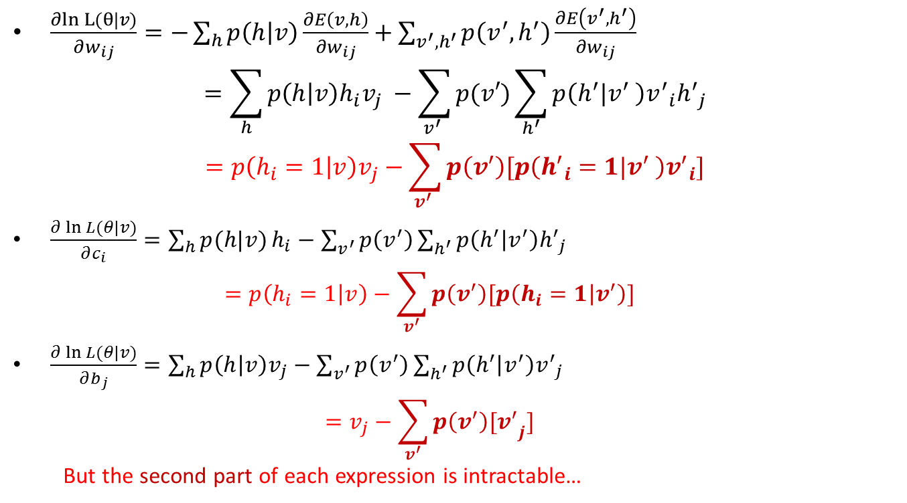
Parameter Updates
$\frac{∂ln L(θ|v)⁡}{∂w_{ij}}=−\sum_{h}{p\left(h | v\right)\frac{∂E\left(v,h\right)}{∂w_{ij}}+\sum_{v^{′},h^{′}}{p\left(v^{′},h^{′}\right)\frac{∂E\left(v^{′},h^{′}\right)}{∂w_{ij}}}}$
$$=\sum_{h}{p\left(h | v\right)h_{i}v_{j} }−\sum_{v^{′} }{p(v′)\sum_{h^{′}}{p\left(h^{′}|v^{′} \right){v^{′}}_{i}{h^{′}}_{j}}}$$
$$=p\left(h_{i}=1 | v\right)v_{j}−\sum_{v^{′} }{p\left(v^{′}\right)[p\left({h^{′}}_{i}=1|v^{′} \right){v^{′}}_{i}]}$$
$\frac{∂\ln{L(θ|v)}}{∂c_{i}}=\sum_{h}{p(h|v)}h_{i}−\sum_{v^{′}}{p\left(v^{′}\right)\sum_{h^{′}}{p\left(h^{′} | v^{′}\right){h^{′}}_{j}^{}}}$
$$=p\left(h_{i}=1 | v\right)−\sum_{v^{′}}{p\left(v^{′}\right)[p\left(h_{i}=1 | v^{′}\right)]}$$
$\frac{∂\ln{L(θ|v)}}{∂b_{j}}=\sum_{h}{p\left(h | v\right)v_{j}}−\sum_{v^{′}}{p\left(v^{′}\right)\sum_{h^{′}}{p\left(h^{′} | v^{′}\right){v^{′}}_{j}^{}}}$
$$=v_{j}−\sum_{v^{′}}{p\left(v^{′}\right){{[v}^{′}}_{j}]}$$
But the second part of each expression is intractable…

Slide 11
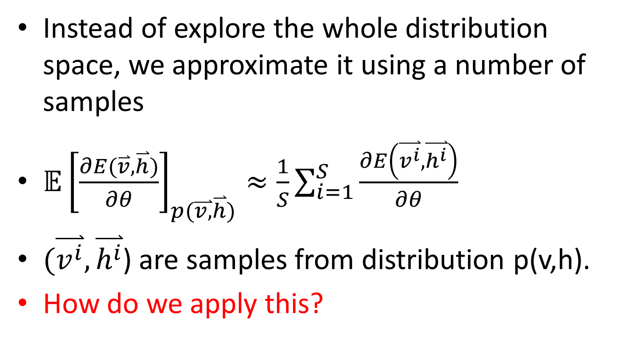
Monte Carlo Approximation
Instead of explore the whole distribution space, we approximate it using a number of samples
${𝔼\left[\frac{∂E(\overset{⃑}{v},\overset{⃑}{h})}{∂θ}\right]}_{p(\overset{⃑}{v,}\overset{⃑}{h})}≈\frac{1}{S}\sum_{i=1}^{S}{\frac{∂E\left(\overset{⃑}{v^{i}},\overset{⃑}{h^{i}}\right)}{∂θ}}$
$(\overset{⃑}{v^{i}},\overset{⃑}{h^{i}}$) are samples from distribution p(v,h).
How do we apply this?

Slide 12
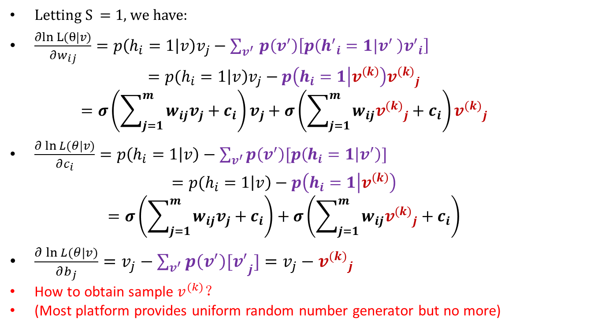
Monte Carlo Approximation for Parameter Updates
Letting S = 1, we have:
$\frac{∂ln L(θ|v)⁡}{∂w_{ij}}=p\left(h_{i}=1 | v\right)v_{j}−\sum_{v^{′} }{p\left(v^{′}\right)\left[p\left({h^{′}}_{i}=1|v^{′} \right){v^{′}}_{i}\right]}$
$$=p(h_{i}=1\left|v\right)v_{j}−p\left(h_{i}=1 | v^{\left(k\right)}\right){v^{\left(k\right)}}_{j}^{}$$
$$=σ\left(\sum_{j=1}^{m}{w_{ij}v_{j}}+c_{i}\right)v_{j}+σ\left(\sum_{j=1}^{m}{w_{ij}{v^{(k)}}_{j}}+c_{i}\right){v^{(k)}}_{j}$$
$\frac{∂\ln{L(θ|v)}}{∂c_{i}}=p\left(h_{i}=1 | v\right)−\sum_{v^{′}}{p\left(v^{′}\right)[p\left(h_{i}=1 | v^{′}\right)]}$
$$=p(h_{i}=1\left|v\right)−p\left(h_{i}=1 | v^{\left(k\right)}\right)$$
$$=σ\left(\sum_{j=1}^{m}{w_{ij}v_{j}}+c_{i}\right)+σ\left(\sum_{j=1}^{m}{w_{ij}{v^{(k)}}_{j}}+c_{i}\right)$$
$\frac{∂\ln{L(θ|v)}}{∂b_{j}}=v_{j}−\sum_{v^{′}}{p\left(v^{′}\right){{[v}^{′}}_{j}]}=v_{j}−{v^{(k)}}_{j}^{}$
How to obtain sample $v^{(k)}$？
(Most platform provides uniform random number generator but no more)

Slide 13
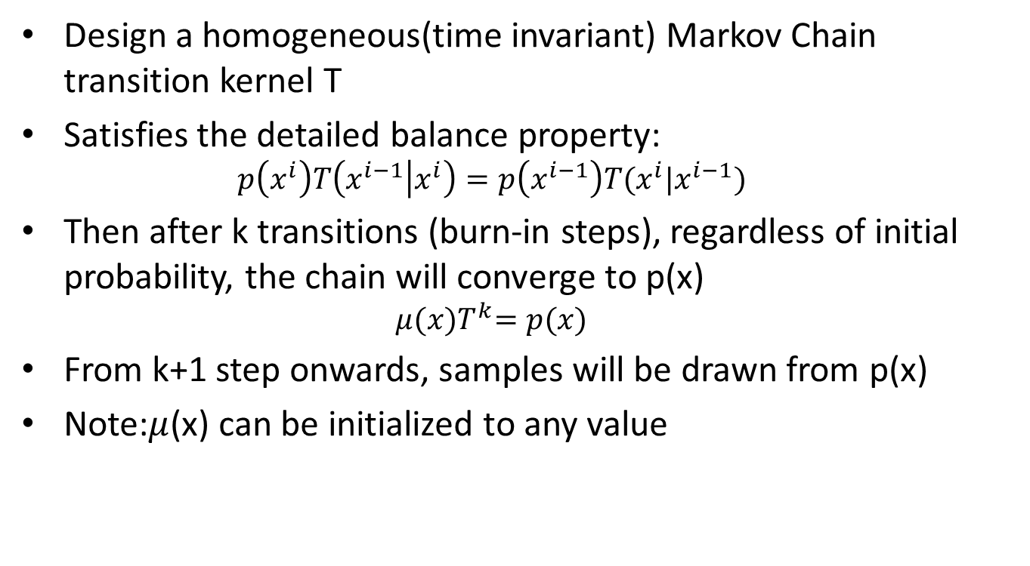
Markov Chain Monte Carlo
Design a homogeneous(time invariant) Markov Chain transition kernel T
Satisfies the detailed balance property:
$$p\left(x^{i}\right)T\left(x^{i−1} | x^{i}\right)=p\left(x^{i−1}\right)T(x^{i}|x^{i−1})$$
Then after k transitions (burn-in steps), regardless of initial probability, the chain will converge to p(x)
$$μ{(x)T}^{k}=p(x)$$
From k+1 step onwards, samples will be drawn from p(x)
Note:$μ$(x) can be initialized to any value

Slide 14
Metropolis-Hastings
MCMC with transition kernel:

Slide 15
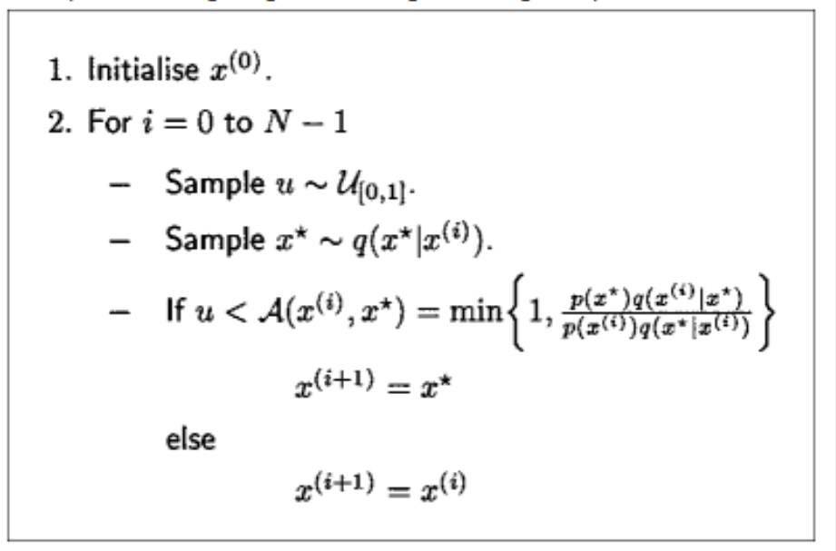
Metropolis-Hastings
Success of the algorithm depends on the design of q
But what about multidimensional samples?

Slide 16
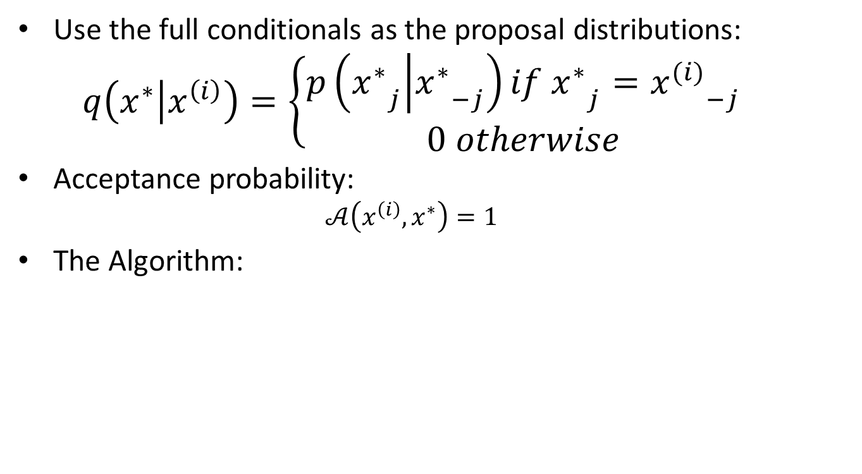
Gibbs Sampling
Use the full conditionals as the proposal distributions:
$$q\left(x^{∗} | x^{\left(i\right)}\right)=\left\{\begin{aligned}p\left({x_{}^{∗}}_{j} | {x_{}^{∗}}_{−j}\right)if {x_{}^{∗}}_{j}={x_{}^{(i)}}_{−j} \\ 0 otherwise\end{aligned}\right.$$
Acceptance probability:
$$𝒜\left(x^{\left(i\right)},x^{∗}\right)=1$$
The Algorithm:

Slide 17
Contrastive Divergence
Blocked Gibbs Sampling with initial samples taken from the training data, with burn-in steps of k-1

Slide 18
Contrastive Divergence

Slide 19
Classification RBM

Slide 20
Classification RBM Supervised Learning
ClassRBM
$$E\left(y,x,h\right)=−h^{T}Wx−b^{T}x−c^{T}h−d^{T}e_{y}−h^{T}Ue_{y}$$
𝐸(𝑦,𝑥,ℎ)=−ℎ^𝑇 𝑊𝑥−𝑏^𝑇 𝑥−𝑐^𝑇 ℎ−𝑑^𝑇 𝑒_𝑦−ℎ^𝑇 𝑈𝑒_𝑦
$$p\left(y,x,h\right)=\frac{1}{Z}e^{−E(y,x,h)}$$
p(𝑦,𝑥,ℎ)=1/𝑍 𝑒^(−𝐸(𝑦,𝑥,ℎ))
$$e_{y}={(1_{i=y})}_{1≤i≤C}^{}$$
𝑒_𝑦=〖(1_(𝑖=𝑦))〗_(1≤𝑖≤𝐶)^

Slide 21
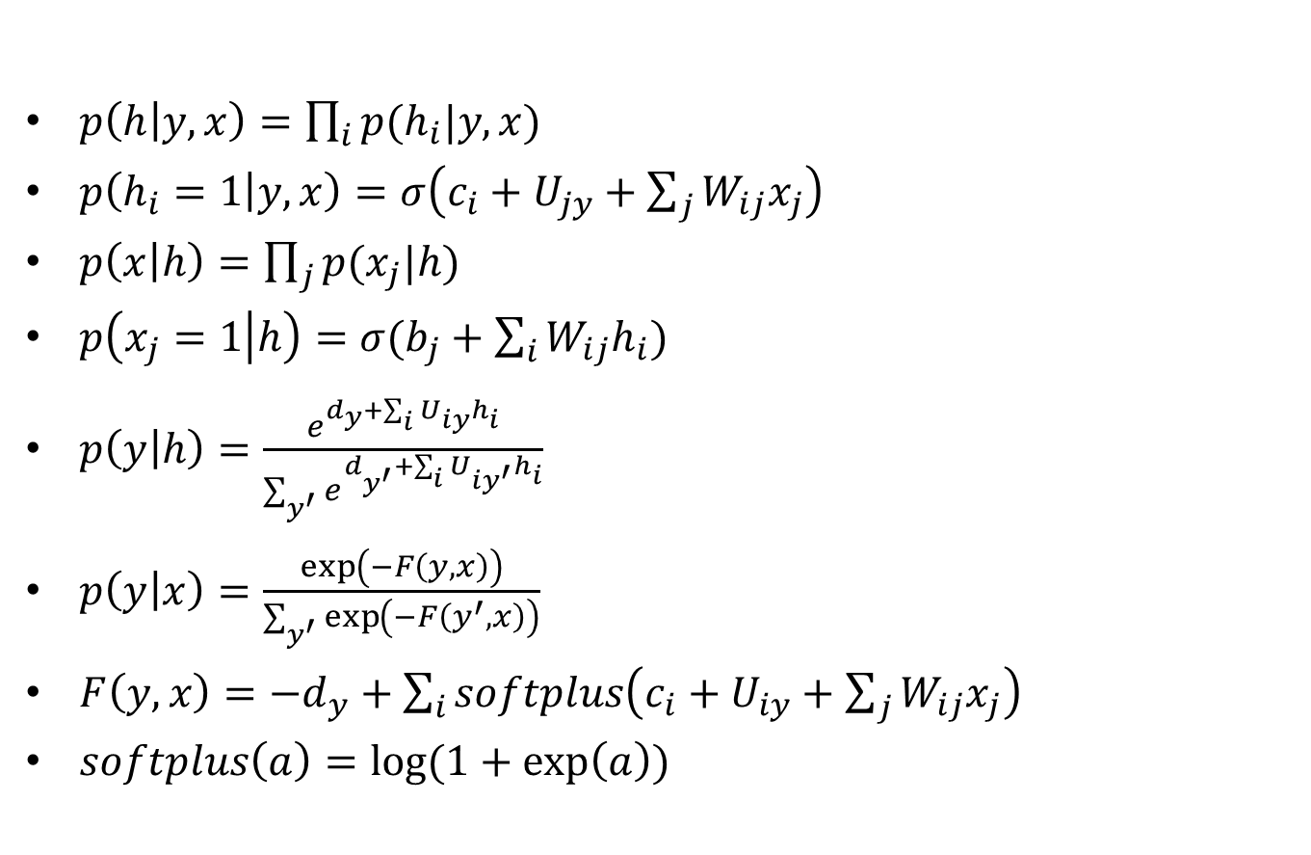
ClassRBM Conditional Independence
$p\left(h | y,x\right)=\prod_{i}{p(h_{i}|y,x)}$
$p\left(h_{i}=1 | y,x\right)=σ\left(c_{i}+U_{jy}+\sum_{j}{W_{ij}x_{j}}\right)$
$p\left(x | h\right)=\prod_{j}{p(x_{j}|h)}$
$p\left(x_{j}=1 | h\right)=σ(b_{j}+\sum_{i}{W_{ij}h_{i}})$
$p\left(y | h\right)=\frac{e^{d_{y}^{}+\sum_{i}{U_{iy}h_{i}}}}{\sum_{y^{′}}{e^{d_{y^{′}}^{}+\sum_{i}{U_{iy^{′}}h_{i}}}}}$
$p\left(y | x\right)=\frac{\exp\left(−F\left(y,x\right)\right)}{\sum_{y^{′}}{\exp\left(−F\left(y^{′},x\right)\right)}}$
$F\left(y,x\right)=−d_{y}+\sum_{i}{softplus\left(c_{i}+U_{iy}+\sum_{j}{W_{ij}x_{j}}\right)}$
$softplus\left(a\right)=log⁡(1+\exp\left(a\right))$

Slide 22
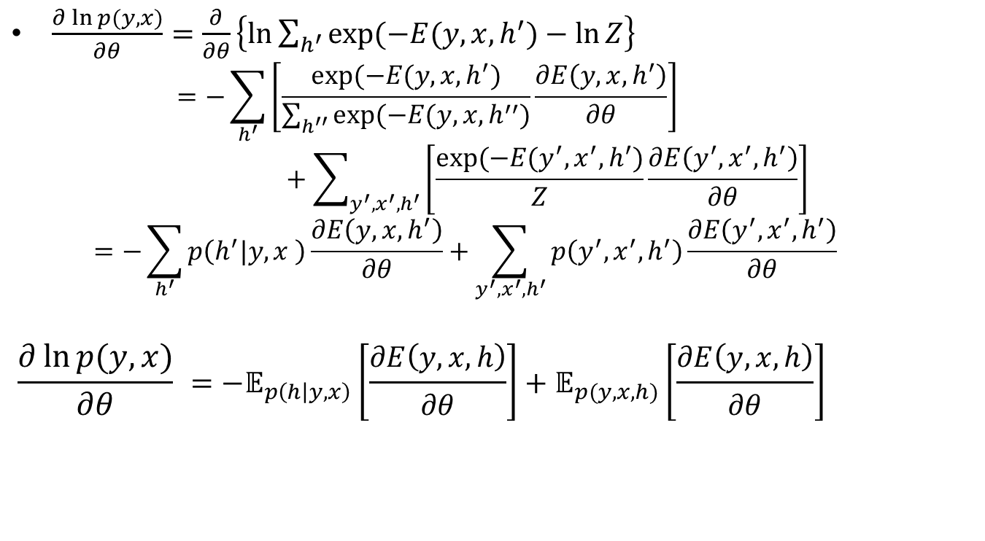
Generative Learning
$\frac{∂\ln{p(y,x)}}{∂θ}=\frac{∂}{∂θ}\left\{\ln{\sum_{h^{′}}{exp⁡(−E(y,x,h^{′})}−\ln{Z}}\right\}$
$$=−\sum_{h^{′}}{\left[\frac{exp⁡(−E(y,x,h^{′})}{\sum_{h^{′′}}{exp⁡(−E(y,x,h^{′′})}}\frac{∂E\left(y,x,h^{′}\right)}{∂θ}\right]}+\sum_{y^{′},x^{′},h^{′}}{\left[\frac{exp⁡(−E(y^{′},x^{′},h^{′})}{Z}\frac{∂E\left(y^{′},x^{′},h^{′}\right)}{∂θ}\right]}$$
$$=−\sum_{h^{′}}{p\left(h^{′}|y,x \right)\frac{∂E\left(y,x,h^{′}\right)}{∂θ}}+\sum_{y^{′},x^{′},h^{′}}{p\left(y^{′},x^{′},h^{′}\right)\frac{∂E\left(y^{′},x^{′},h^{′}\right)}{∂θ}}$$
$$\frac{∂\ln{p(y,x)}}{∂θ} ={−𝔼}_{p\left(h | y,x\right)}\left[\frac{∂E\left(y,x,h\right)}{∂θ}\right]+𝔼_{p(y,x,h)}\left[\frac{∂E\left(y,x,h\right)}{∂θ}\right]$$

Slide 23
Generative Learning

Slide 24
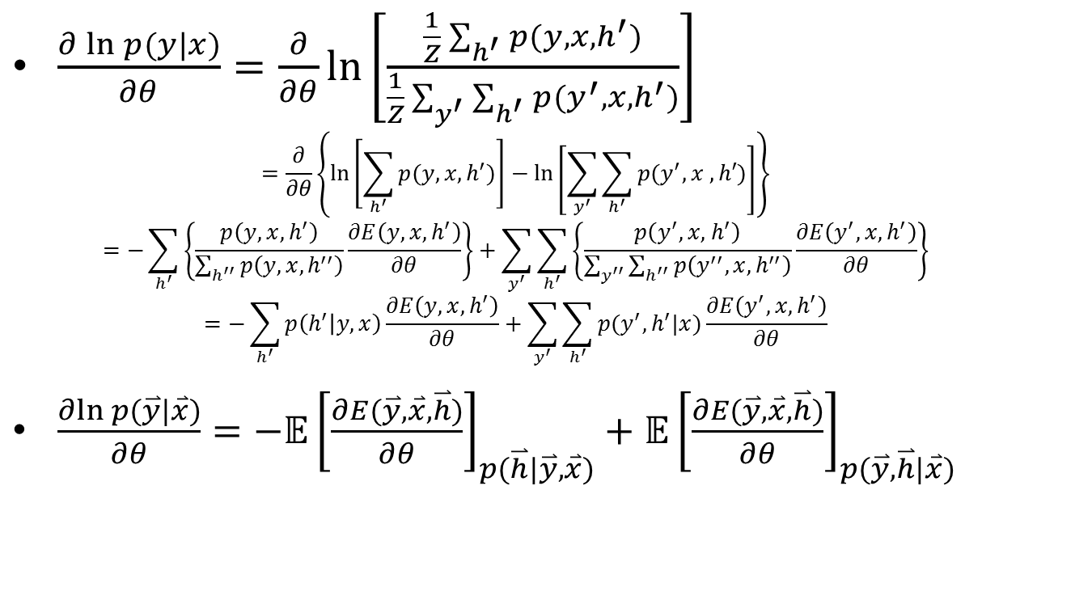
Discriminative Learning
$\frac{∂\ln{p(y|x)}}{∂θ}=\frac{∂}{∂θ}\ln\left[\frac{\frac{1}{Z}\sum_{h^{′}}{p(y,x,h^{′})}}{\frac{1}{Z}\sum_{y^{′}}{\sum_{h^{′}}{p(y^{′},x,h^{′})}}}\right]$
$$=\frac{∂}{∂θ}\left\{\ln\left[\sum_{h^{′}}{p(y,x,h^{′})}\right]−\ln\left[\sum_{y^{′}}{\sum_{h^{′}}{p(y^{′},x ,h′)}}\right]\right\}$$
$$=−\sum_{h^{′}}{\left\{\frac{p\left(y,x,h^{′}\right)}{\sum_{h^{′′}}{p\left(y,x,h^{′′}\right)}}\frac{∂E\left(y,x,h^{′}\right)}{∂θ}\right\}}+\sum_{y^{′}}{\sum_{h^{′}}{\left\{\frac{p\left(y^{′}, x,{ h}^{′}\right)}{\sum_{y^{′′}}{\sum_{h^{′′}}{p\left(y^{′′},x,h^{′′}\right)}}}\frac{∂E\left(y^{′},x,h^{′}\right)}{∂θ}\right\}}}$$
$$=−\sum_{h^{′}}{p\left(h^{′} | y,x\right)\frac{∂E\left(y,x,h^{′}\right)}{∂θ}}+\sum_{y^{′}}{\sum_{h^{′}}{p(y^{′},h^{′}|x)\frac{∂E\left(y^{′},x,h^{′}\right)}{∂θ}}}$$
$\frac{∂ln p(\overset{⃑}{y}|\overset{⃑}{x})}{∂θ}={−𝔼\left[\frac{∂E(\overset{⃑}{y},\overset{⃑}{x},\overset{⃑}{h})}{∂θ}\right]}_{p(\overset{⃑}{h}|\overset{⃑}{y},\overset{⃑}{x})}+{𝔼\left[\frac{∂E(\overset{⃑}{y},\overset{⃑}{x},\overset{⃑}{h})}{∂θ}\right]}_{p(\overset{⃑}{y},\overset{⃑}{h}|\overset{⃑}{x})}$

Slide 25
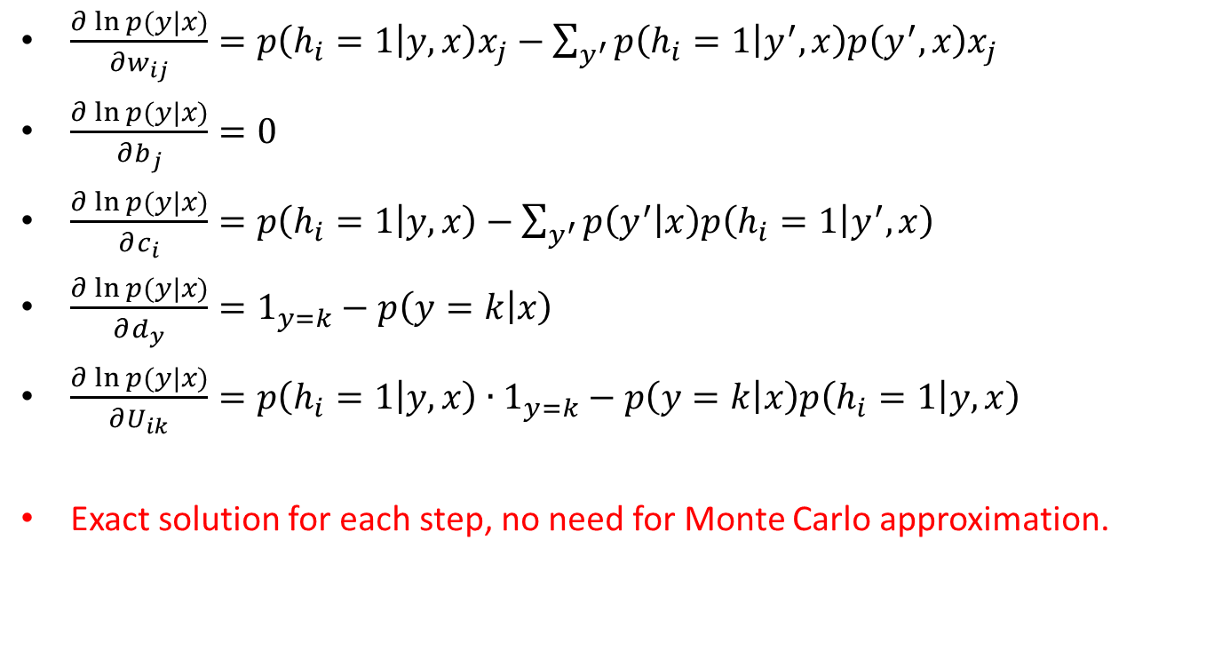
Gradients of Disc-Learning
$\frac{∂\ln{p(y|x)}}{∂w_{ij}}=p\left(h_{i}=1 | y,x\right)x_{j}−\sum_{y^{′}}{p\left(h_{i}=1 | y^{′},x\right)p\left(y^{′},x\right)x_{j}}$
$\frac{∂\ln{p(y|x)}}{∂b_{j}}=0$
$\frac{∂\ln{p(y|x)}}{∂c_{i}}=p\left(h_{i}=1 | y,x\right)−\sum_{y^{′}}{p\left(y^{′} | x\right)p\left(h_{i}=1 | y^{′},x\right)}$
$\frac{∂\ln{p(y|x)}}{∂d_{y}}=1_{y=k}−p\left(y=k | x\right)$
$\frac{∂\ln{p(y|x)}}{∂U_{ik}}=p\left(h_{i}=1 | y,x\right)∙1_{y=k}−p\left(y=k | x\right)p\left(h_{i}=1 | y,x\right)$
Exact solution for each step, no need for Monte Carlo approximation.

Slide 26
Hybrid Learning

Slide 27
Why Hybrid Learning
“Adding the generative training objective to the discriminative training objective can be seen as a way to regularize the discriminative training objective…”
“…among all configurations of the parameters of the ClassRBM, we will favor those that also assign high probability to the inputs and hence have extracted some of the structure present in the input distribution…”

Slide 28
Classification RBM for pCTR

Slide 29
Classification RBM for pCTR
Issues:
Feature Set: Millions (Number of visible units)
Distinct Training Instances: 400 Millions (60 days)
Log data: terabytes
Input sparsity:
Each training instances contains less than 100 features (the rest are all zeros)
Inherent Structure in Input
Features form feature classes, and each instance contains only one feature from each feature class
How do we encode this knowledge into ClassRBM?
Can we make use of this knowledge to make it easier to train ClassRBM?

Slide 30
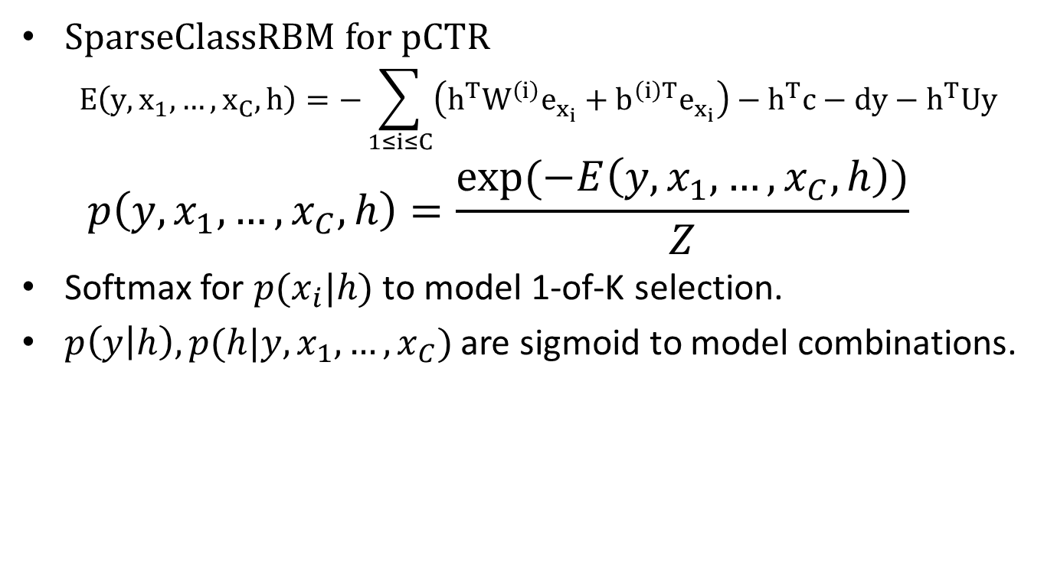
Sparse Classification RBM for pCTR
SparseClassRBM for pCTR
$$E\left(y,x_{1},…,x_{C},h\right)=−\sum_{1≤i≤C}{\left(h^{T}W_{}^{\left(i\right)}e_{x_{i}}+b^{\left(i\right)T}e_{x_{i}}\right)−h^{T}c−dy−h^{T}Uy}$$
$$p\left(y,x_{1},…,x_{C},h\right)=\frac{exp⁡(−E\left(y,x_{1},…,x_{C},h\right))}{Z}$$
Softmax for $p(x_{i}|h)$ to model 1-of-K selection.
$p\left(y | h\right),p(h|y,x_{1},…,x_{C})$ are sigmoid to model combinations.

Slide 31
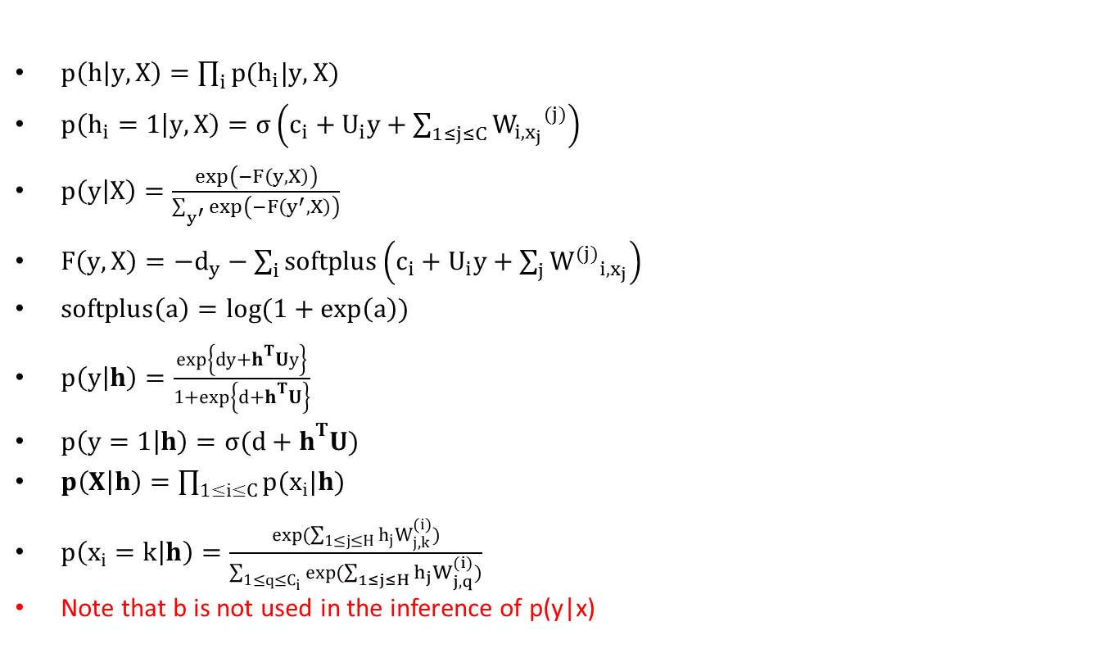
Sparse Classification RBM for pCTR
$p\left(h | y,X\right)=\prod_{i}{p(h_{i}|y,X)}$
$p\left(h_{i}=1 | y,X\right)=σ\left(c_{i}+U_{i}y+\sum_{1≤j≤C}{{W_{i,x_{j}}}^{(j)}}\right)$
$p\left(y | X\right)=\frac{\exp\left(−F\left(y,X\right)\right)}{\sum_{y^{′}}{\exp\left(−F\left(y^{′},X\right)\right)}}$
$F\left(y,X\right)=−d_{y}−\sum_{i}{softplus\left(c_{i}+U_{i}y+\sum_{j}{{W^{(j)}}_{i,x_{j}}}\right)}$
$softplus\left(a\right)=log⁡(1+\exp\left(a\right))$
$p\left(y | h\right)=\frac{\exp\left\{dy+h^{T}Uy\right\}}{1+\exp\left\{d+h^{T}U\right\}}$
$p\left(y=1 | h\right)=σ(d+h^{T}U)$
$p\left(X | h\right)=\prod_{1≤i≤C}{p(x_{i}|h)}$
$p\left(x_{i}=k | h\right)=\frac{\exp{(\sum_{1≤j≤H}{h_{j}W_{j,k}^{(i)}})}}{\sum_{1≤q≤C_{i}}{exp(\sum_{1≤j≤H}{h_{j}W_{j,q}^{(i)}})}}$
Note that b is not used in the inference of p(y|x)

Slide 32
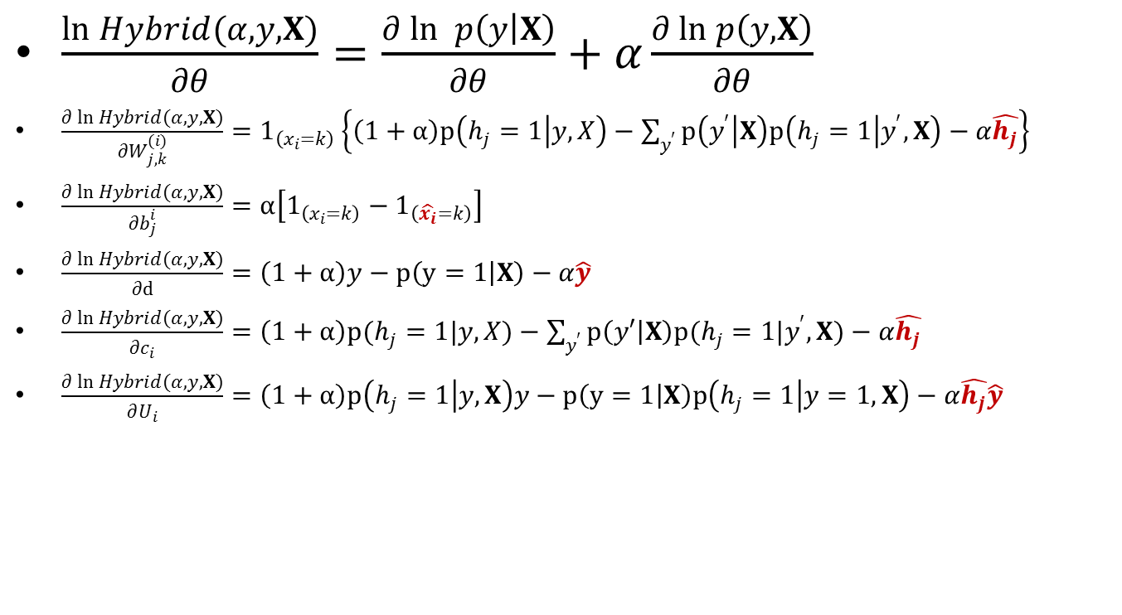
Learning SparseClassRBM
$\frac{\ln{Hybrid(α,y,X)}}{∂θ}=\frac{∂\ln{ p\left(y | X\right)}}{∂θ}+α\frac{∂\ln{p\left(y,X\right)}}{∂θ}$
$\frac{∂\ln{Hybrid(α,y,X)}}{∂W_{j,k}^{(i)}}=1_{\left(x_{i}=k\right)}\left\{\left(1+α\right)p\left(h_{j}=1 | y,X\right)−\sum_{y^{′}}{p\left(y^{′} | X\right)p\left(h_{j}=1 | y^{′},X\right)}−α\hat{h_{j}}\right\}$
$\frac{∂\ln{Hybrid(α,y,X)}}{∂b_{j}^{i}}=α\left[1_{\left(x_{i}=k\right)}−1_{\left(\hat{x_{i}}=k\right)}\right]$
$\frac{∂\ln{Hybrid(α,y,X)}}{∂d}=\left(1+α\right)y−p\left(y=1 | X\right)−α\hat{y}$
$\frac{∂\ln{Hybrid(α,y,X)}}{∂c_{i}}=\left(1+α\right)p(h_{j}=1|y,X)−\sum_{y^{′}}{p\left(y′ | X\right)p(h_{j}=1|y^{′},X)}−α\hat{h_{j}}$
$\frac{∂\ln{Hybrid(α,y,X)}}{∂U_{i}}=\left(1+α\right)p\left(h_{j}=1 | y,X\right)y−p\left(y=1 | X\right)p\left(h_{j}=1 | y=1,X\right)−α\hat{h_{j}}\hat{y}$

Slide 33
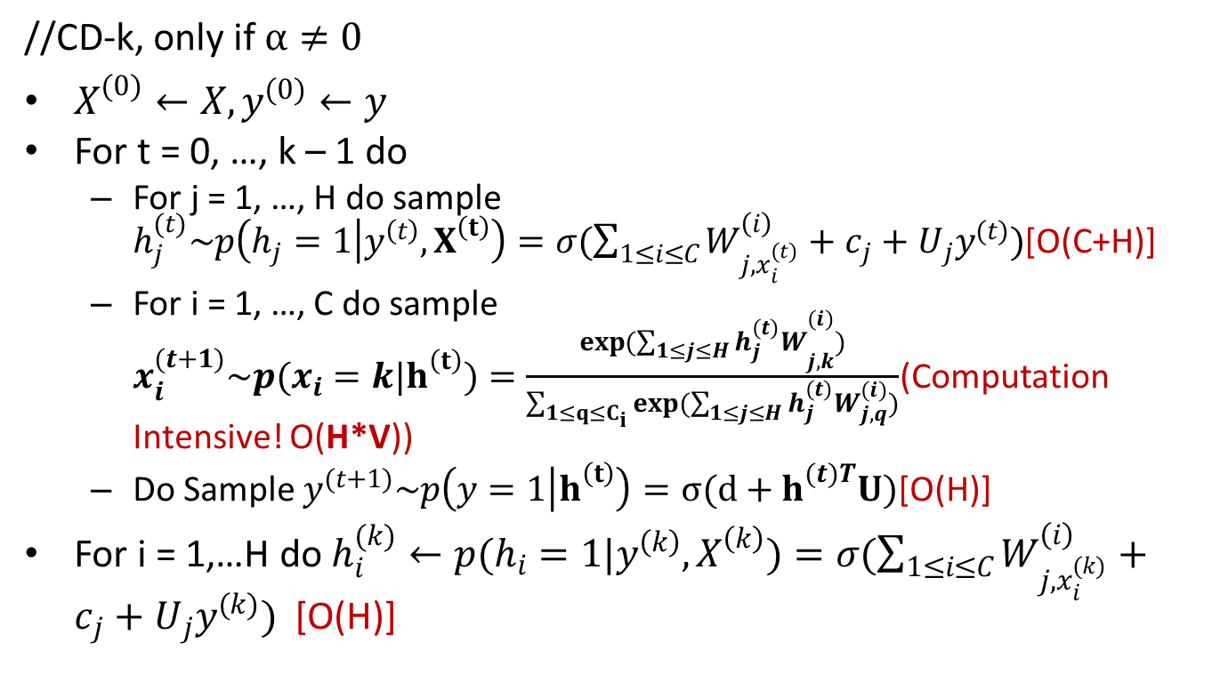
Training SparseClassRBM (CD-k)
//CD-k, only if $α≠0$
$X^{(0)}←X,y^{(0)}←y$
For t = 0, …, k – 1 do
For j = 1, …, H do sample $h_{j}^{(t)}\sim p\left(h_{j}=1 | y^{\left(t\right)},X^{\left(t\right)}\right)=σ(\sum_{1≤i≤C}{W_{j,x_{i}^{(t)}}^{\left(i\right)}}+c_{j}+U_{j}y^{(t)})$[O(C+H)]
For i = 1, …, C do sample $x_{i}^{(t+1)}\sim p(x_{i}=k|h^{\left(t\right)})=\frac{\exp{(\sum_{1≤j≤H}{{h_{j}^{(t)}W}_{j,k}^{(i)}})}}{\sum_{1≤q≤C_{i}}{exp(\sum_{1≤j≤H}{h_{j}^{(t)}W_{j,q}^{(i)}})}}$(Computation Intensive! O(H*V))
Do Sample $y^{(t+1)}\sim p\left(y=1 | h^{\left(t\right)}\right)=σ(d+h^{(t)T}U)$[O(H)]
For i = 1,…H do $h_{i}^{(k)}←p(h_{i}=1|y^{\left(k\right)},X^{\left(k\right)})=σ(\sum_{1≤i≤C}{W_{j,x_{i}^{(k)}}^{\left(i\right)}}+c_{j}+U_{j}y^{(k)})$ [O(H)]

Slide 34
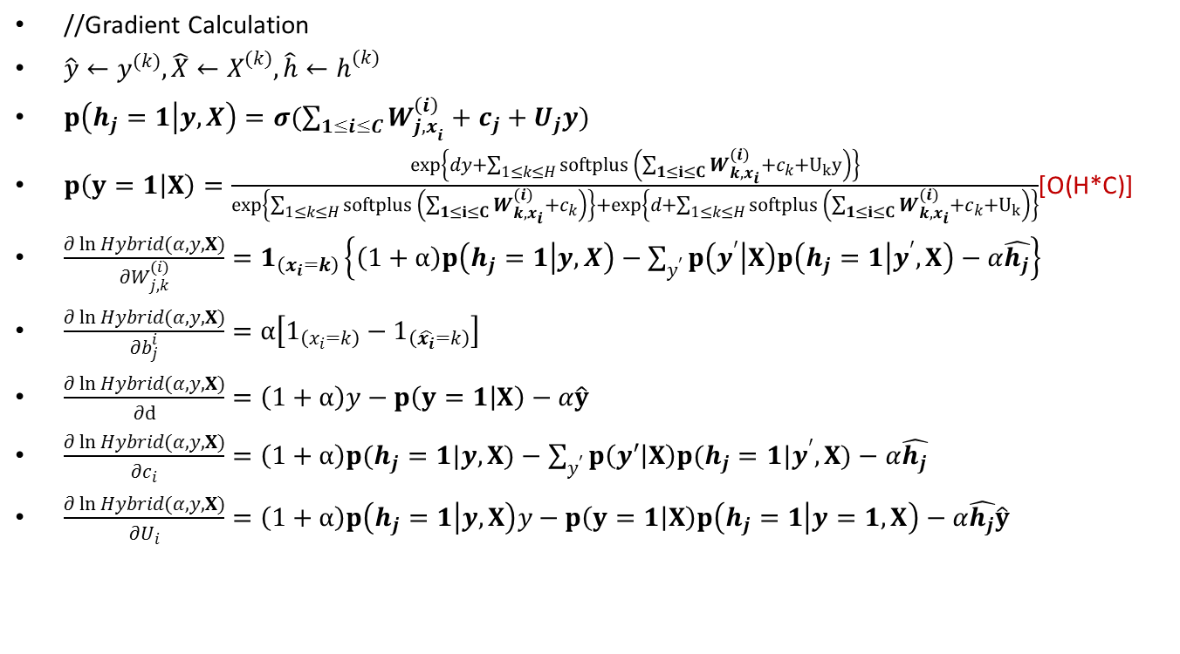
Training SparseClassRBM (Gradients Calculation)
//Gradient Calculation
$\hat{y}←y^{(k)},\hat{X}←X^{(k)},\hat{h}←h^{(k)}$
$p\left(h_{j}=1 | y,X\right)=σ(\sum_{1≤i≤C}{W_{{j,x}_{i}}^{\left(i\right)}}+c_{j}+U_{j}y)$
$p\left(y=1 | X\right)=\frac{exp\left\{dy+\sum_{1≤k≤H}{softplus \left(\sum_{1≤i≤C}{W_{k,x_{i}}^{(i)}}+c_{k}+U_{k}y\right)}\right\}}{exp\left\{\sum_{1≤k≤H}{softplus \left(\sum_{1≤i≤C}{W_{k,x_{i}}^{(i)}}+c_{k}\right)}\right\}+exp\left\{d+\sum_{1≤k≤H}{softplus \left(\sum_{1≤i≤C}{W_{k,x_{i}}^{(i)}}+c_{k}+U_{k}\right)}\right\}}$[O(H*C)]
$\frac{∂\ln{Hybrid(α,y,X)}}{∂W_{j,k}^{(i)}}=1_{\left(x_{i}=k\right)}\left\{\left(1+α\right)p\left(h_{j}=1 | y,X\right)−\sum_{y^{′}}{p\left(y^{′} | X\right)p\left(h_{j}=1 | y^{′},X\right)}−α\hat{h_{j}}\right\}$
$\frac{∂\ln{Hybrid(α,y,X)}}{∂b_{j}^{i}}=α\left[1_{\left(x_{i}=k\right)}−1_{\left(\hat{x_{i}}=k\right)}\right]$
$\frac{∂\ln{Hybrid(α,y,X)}}{∂d}=\left(1+α\right)y−p\left(y=1 | X\right)−α\hat{y}$
$\frac{∂\ln{Hybrid(α,y,X)}}{∂c_{i}}=\left(1+α\right)p(h_{j}=1|y,X)−\sum_{y^{′}}{p\left(y′ | X\right)p(h_{j}=1|y^{′},X)}−α\hat{h_{j}}$
$\frac{∂\ln{Hybrid(α,y,X)}}{∂U_{i}}=\left(1+α\right)p\left(h_{j}=1 | y,X\right)y−p\left(y=1 | X\right)p\left(h_{j}=1 | y=1,X\right)−α\hat{h_{j}}\hat{y}$

Slide 35
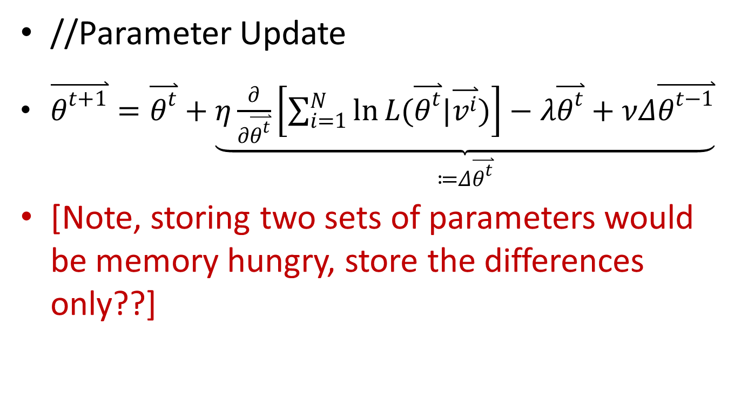
Training SparseClassRBM (Parameter Updates)
//Parameter Update
$\overset{⃑}{θ^{t+1}}=\overset{⃑}{θ^{t}}+\underset{≔Δ\overset{⃑}{θ^{t}}}{\underbrace{η\frac{∂}{∂\overset{⃑}{θ^{t}}}\left[\sum_{i=1}^{N}{\ln{L(\overset{⃑}{θ^{t}}|\overset{⃑}{v^{i}})}}\right]−λ\overset{⃑}{θ^{t}}+νΔ\overset{⃑}{θ^{t−1}}}}$
[Note, storing two sets of parameters would be memory hungry, store the differences only??]

Slide 36
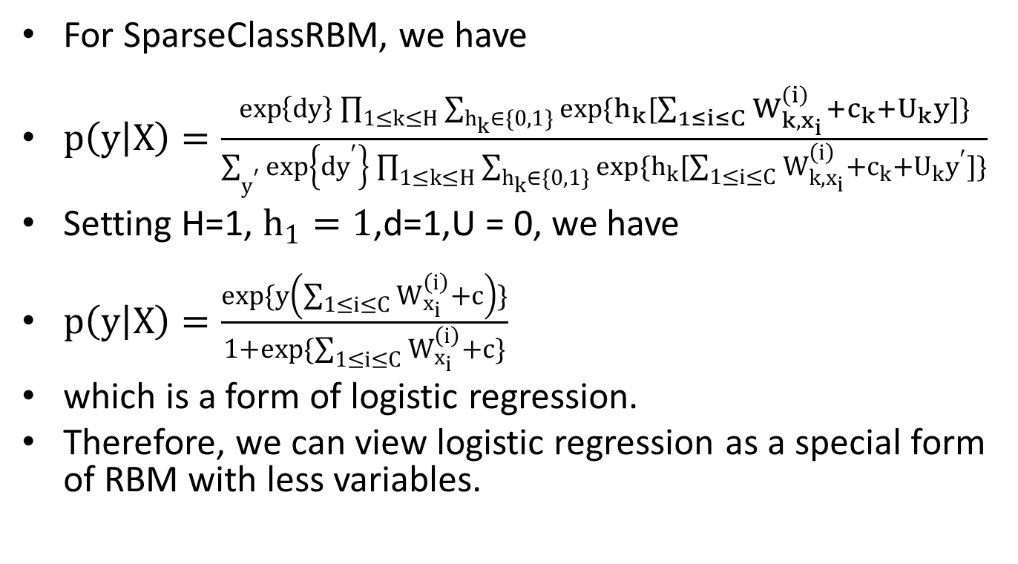
ClassRBM VS Logistic Regression
For SparseClassRBM, we have
$p\left(y | X\right)=\frac{\exp\left\{dy\right\}\prod_{1≤k≤H}{\sum_{h_{k}∈\{0,1\}}{exp\{h_{k}[\sum_{1≤i≤C}{W_{k,x_{i}}^{\left(i\right)}}+c_{k}+U_{k}y]\}}}}{\sum_{y^{′}}{\exp\left\{{dy}^{′}\right\}\prod_{1≤k≤H}{\sum_{h_{k}∈\{0,1\}}{exp\{h_{k}[\sum_{1≤i≤C}{W_{k,x_{i}}^{\left(i\right)}}+c_{k}+U_{k}y^{′}]\}}}}}$
Setting H=1, $h_{1}=1$,d=1,U = 0, we have
$p\left(y | X\right)=\frac{exp\{y\left(\sum_{1≤i≤C}{W_{x_{i}}^{\left(i\right)}}+c\right)\}}{1+exp\{\sum_{1≤i≤C}{W_{x_{i}}^{\left(i\right)}}+c\}}$
which is a form of logistic regression.
Therefore, we can view logistic regression as a special form of RBM with less variables.

Slide 37
ClassRBM VS Logistic Regress
Logisic Regression
One Layer Flat Model, feature combinations are hand-coded
Use L1-Norm to select features and avoid over-fitting
SparseClassRBM
Two Layer Model, can automatically learn feature combinations
Use L1-Norm, hybrid-training and early stopping to avoid over-fitting
Easily explained
Hard to explain

Slide 38
Open Questions
Incremental Learning?
Ruping, Incremental Learning with Support Vector Machines
Online Learning?
?
Momentum Learning might not be enough
Exploration-and-exploitation?
?
Comparison to Google’s solution?
?
Stability of the Model?
Two models trained from the same data should produce the same prediction?

Slide 39
Reference
Fischer, 2012, An Introduction to Restricted Boltzmann Machines,
http://image.diku.dk/igel/paper/AItRBM-proof.pdf
H. Larochelle, Y. Bengio, 2008, Classification using Discriminative Restricted Boltzmann Machines,
http://machinelearning.org/archive/icml2008/papers/601.pdf
Y. Bengio, 2007, Justifying and Generalizing Contrastive Divergence
www.cs.toronto.edu/~hinton/absps/guideTR.pdf
C.Andrieu, 2003, An Introduction to MCMC for Machine Learning,
http://www.cs.princeton.edu/courses/archive/spr06/cos598C/papers/AndrieuFreitasDoucetJordan2003.pdf
Geoffrey Hinton, 2010, A Practical Guide to Training Restricted Boltzmann Machines,
http://www.iro.umontreal.ca/~lisa/pointeurs/bengio+delalleau-tr1311.pdf
H. Larochelle, 2012, Learning Algorithms for the Classification Restricted Boltzmann Machines,
http://jmlr.csail.mit.edu/papers/volume13/larochelle12a/larochelle12a.pdf

Slide 40
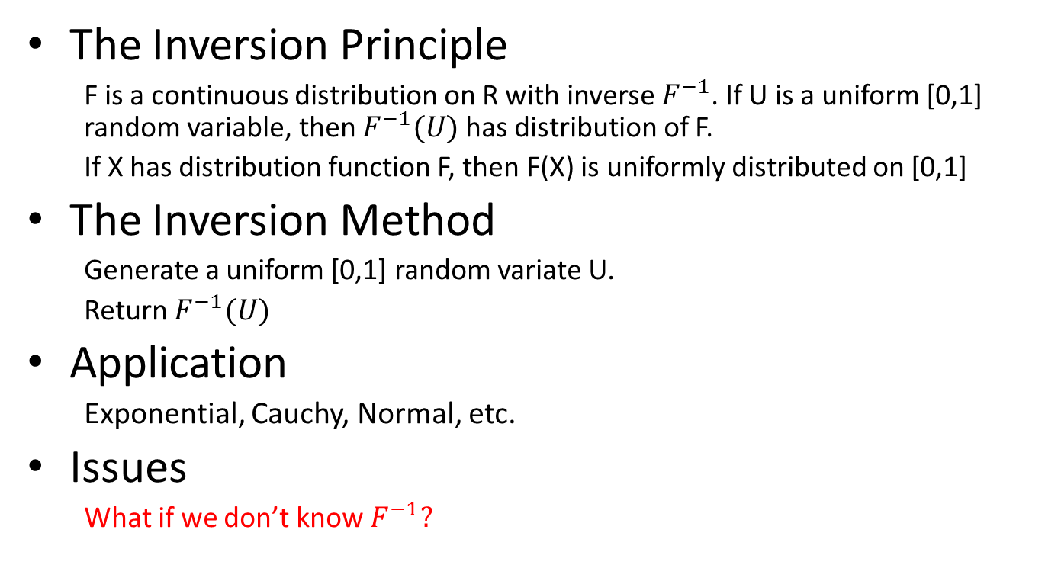
Inverse Transform Sampling
The Inversion Principle
F is a continuous distribution on R with inverse $F^{−1}$. If U is a uniform [0,1] random variable, then $F^{−1}(U)$ has distribution of F.
If X has distribution function F, then F(X) is uniformly distributed on [0,1]
The Inversion Method
Generate a uniform [0,1] random variate U.
Return $F^{−1}(U)$
Application
Exponential, Cauchy, Normal, etc.
Issues
What if we don’t know $F^{−1}?$

Slide 41
Inverse Transform Sampling

Slide 42
Simple Sampling Methods
Binomial Sampling
U(0,1) < p(x)
Multinomial Sampling

Slide 43
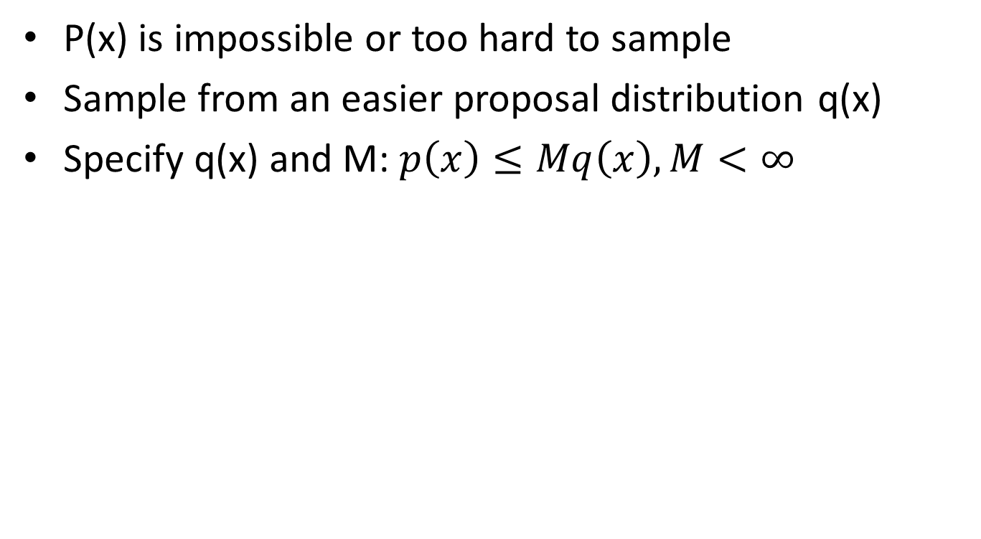
Rejection Sampling
P(x) is impossible or too hard to sample
Sample from an easier proposal distribution q(x)
Specify q(x) and M: $p\left(x\right)≤Mq\left(x\right),M<∞$

Slide 44
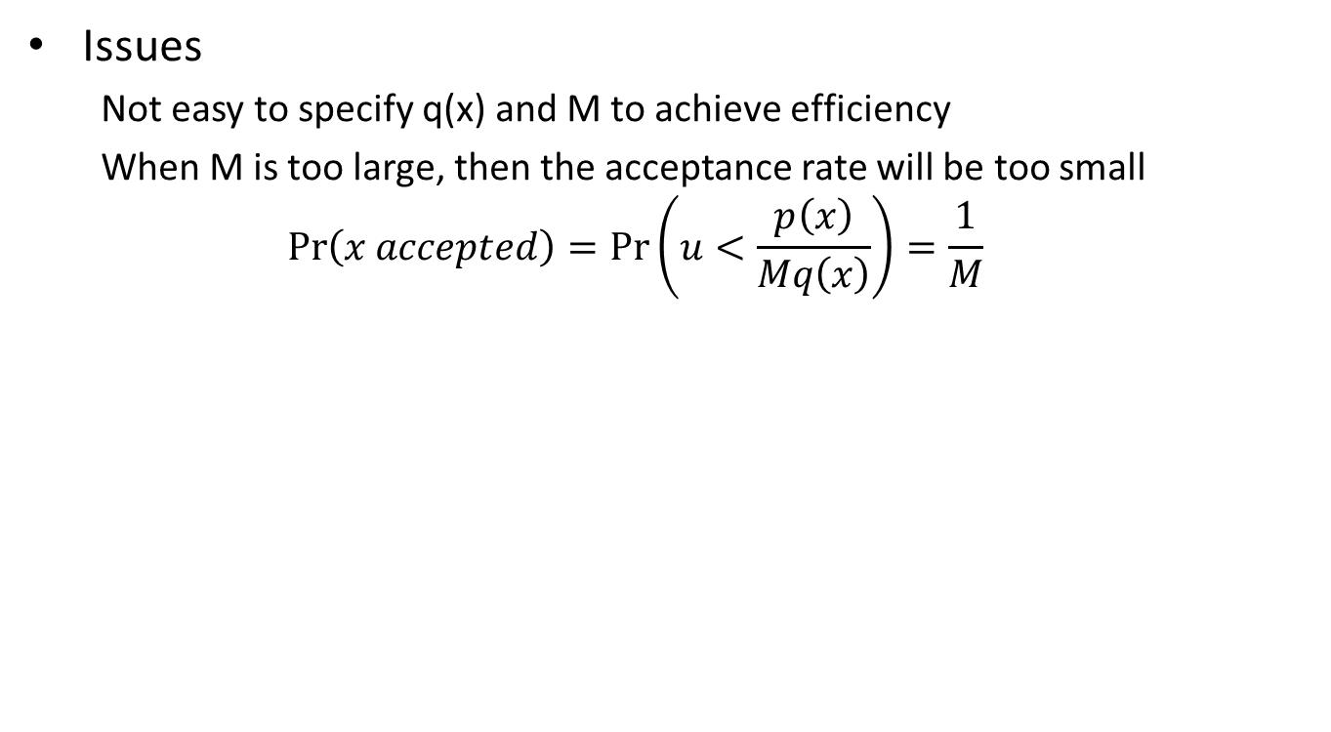
Rejection Sampling
Issues
Not easy to specify q(x) and M to achieve efficiency
When M is too large, then the acceptance rate will be too small
$$\operatorname{Pr}\left(x accepted\right)=\operatorname{Pr}\left(u<\frac{p\left(x\right)}{Mq\left(x\right)}\right)=\frac{1}{M}$$

